Slide 1
Touch Typing Course Part 5

Slide 2

Content
After finishing the lesson student will be able to:
Typing without watching their keyboard smoothly from letters A-Z
Keys B and Y
Keys Z and X

Slide 3
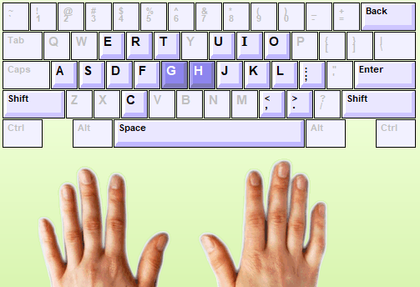
Keys G H and apostrophe
The keys G and H located on the same the home row. Key G and H are typed using the Index fingers.
Notes:
Desktop can’t move during using because no power supply
Laptop can move to everywhere because it has power supply

Slide 4
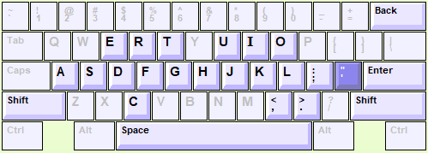
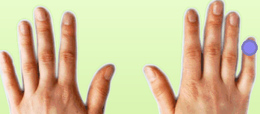
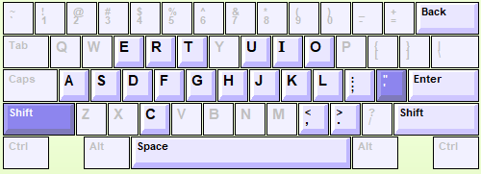
Keys G H and apostrophe
Single quote key is typed use right little finger.
Double quote key is typed use:
1). Hold Shift with left little finger
2). Press “ key with right little finger”
Notes:
Desktop can’t move during using because no power supply
Laptop can move to everywhere because it has power supply

Slide 5
Practice
1). Turn on your computer
2). Login into Typing Master with your account
3). Start to typing on “lesson seven= Keys B and Y”
New keys: B Y= 5 min
Word drill = 5 min
Bubbles Game = 5 min
Word drill= 5min
Sentence drill= 5 min
Paragraph drill= 2 times (5x2=10min)
Lesson exam =10min
Students follow with instruction from Teacher one by one.
Notes:
Let them do it

Slide 6
Practice
1). Turn on your computer
2). Login into Typing Master with your account
3). Start to typing on “lesson night= Keys W and M”
New keys: Z X= 5 min
Word drill = 5 min
Bubbles Game = 5 min
Word drill= 5min
Sentence drill= 5 min
Paragraph drill= 2 times (5x2=10min)
Lesson exam =10min
Students follow with instruction from Teacher one by one.
Notes:
Let them do it

Slide 7
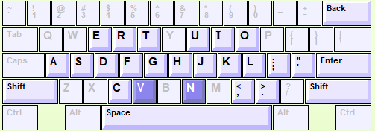
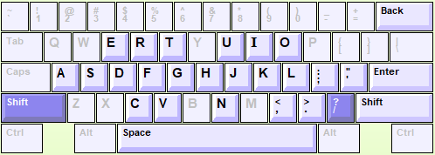
Keys B and Y
The keys B and Y are typed using the Index Fingers
The keys ? Located below the home row. ? Are typed using :
Hold Shift with left little ginger
Press “?” key with right little finger
Notes:
Desktop can’t move during using because no power supply
Laptop can move to everywhere because it has power supply

Slide 8
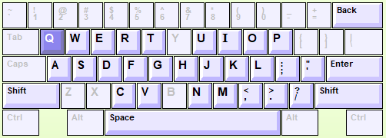
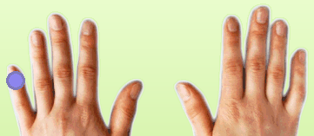
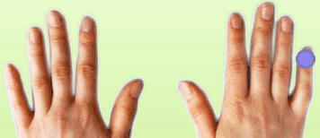
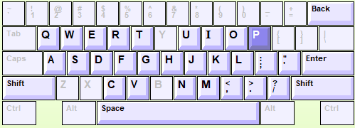
Keys Z and X
The keys X typed using the left little Finger.
The keys Z and X typed using the Left little Finger.
Notes:
Desktop can’t move during using because no power supply
Laptop can move to everywhere because it has power supply

Slide 9
HOMEWORK
Student Needs to finish homework both in chapters Eleven and Twelve in Typing Master before the next session by completing “ Lesson Exam”.
If you do not complete, you can’t continue to the next chapter.
So it means you need to qualify with speed in 10 min:
Less 15 wpm = 45 ( can’t continue)
15-19 wpm= 50
20-24 wpm = 60
25-29 wpm = 70
30-34 wpm =80
35-39 wpm = 90
40 up wpm= 100
Note: The teacher can check all your records typing. Do your best!

Slide 10

Login to Typing Master by your account
Open lesson 8 and 10 “ Lesson Exam” in Typing Master
Your full score 40wpm= 100pts

Slide 11

Any Question ????

